Slide 1
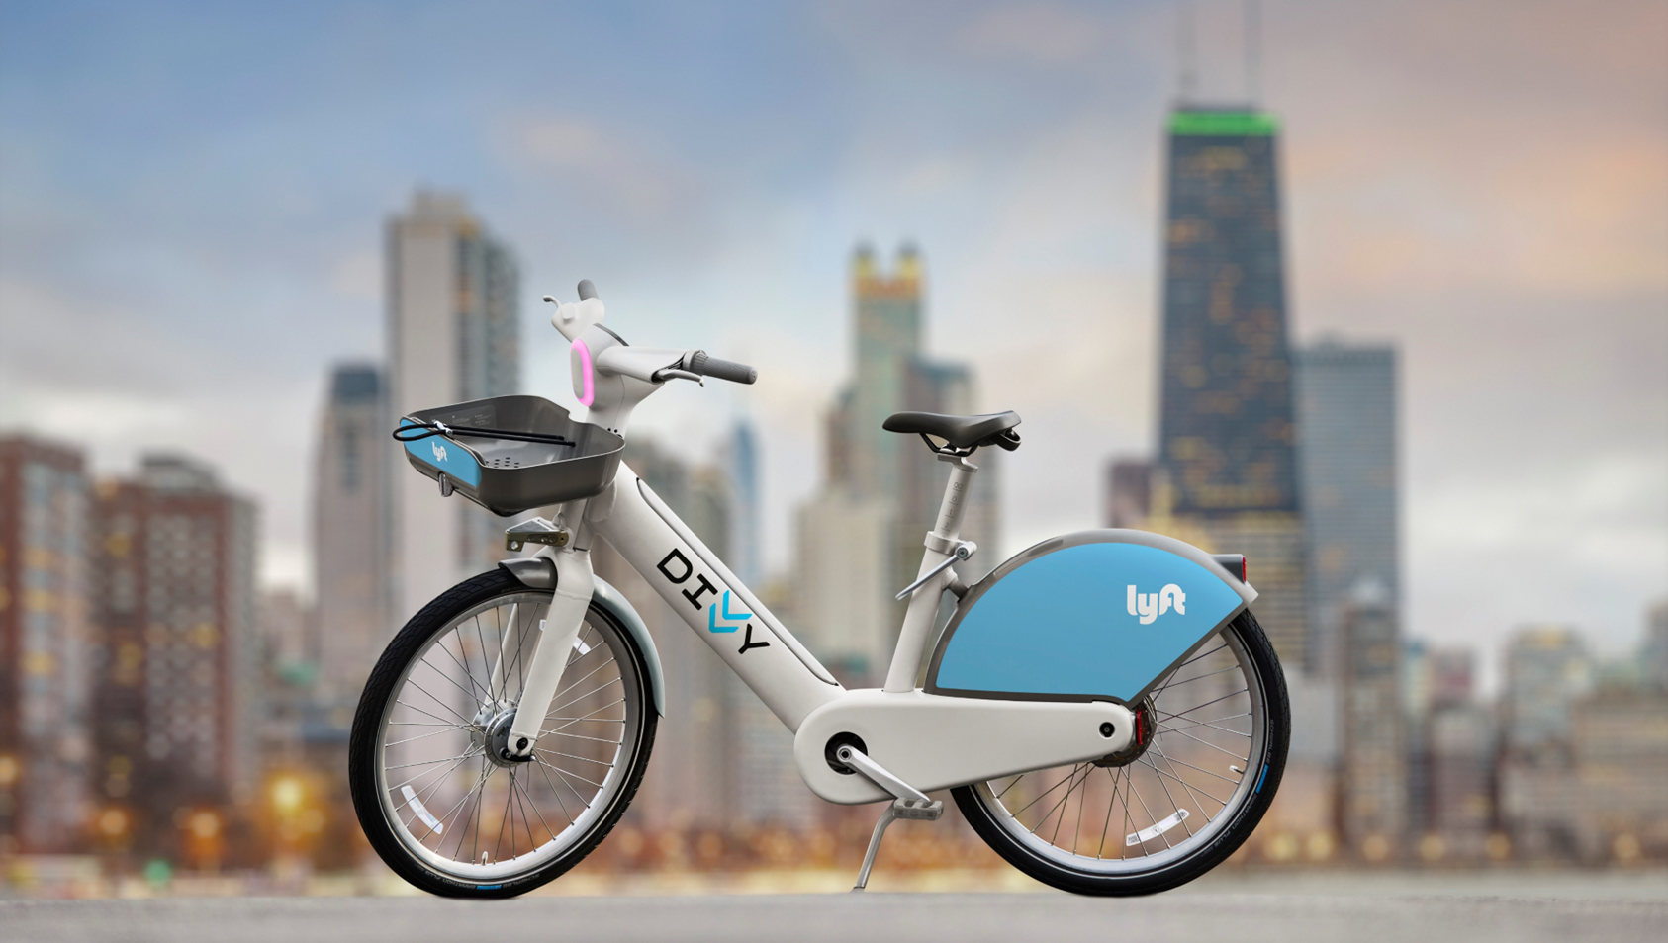

Data Visualisation – Bike rides in Chicago “Data Visualisation” February 14th, 2023 By Yen & Bulduk IronHack Paris

Slide 2
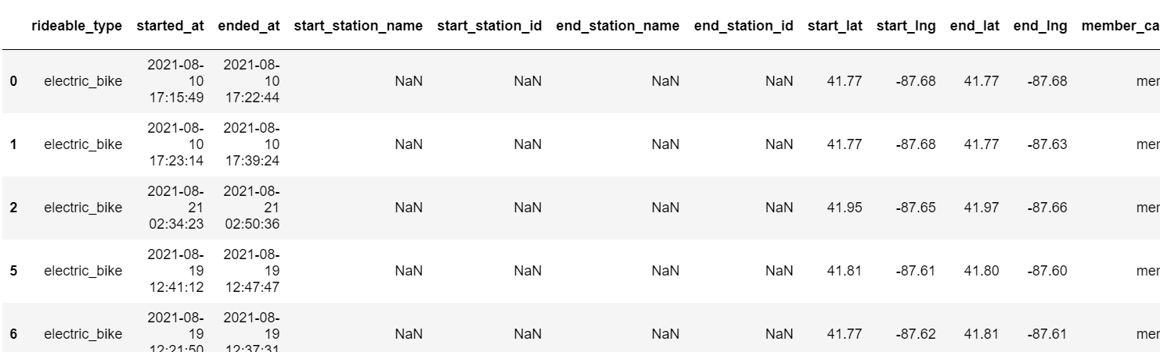
Dataset & Variables
Bike rides from Chicago, from August 2021 to July 2022:
3,2M+ entries, variables:
Bike type (Electric, Classic, Docked)
Date & Time of ride start / ride end => To which is extracted Year, Month, Hour, Minute
Station name & id
Starting latitude & longitude / Ending latitude & longitude
Membership (Member or Casual user)
Notes:
Bulduk

Slide 3
Challenges
Find variable to analysis
Only one continuous variable : ride length. Limits the usage of 3D scatter plot for instance.
Size of data
3.2M+ entries, 800 Mo csv file, which makes some codes’ execution long (up to 5 minutes)
Times
Coding complex charts takes long time
Notes:
Bulduk

Slide 4
Process
Exploring data (value_counts, unique value, etc.), to see every possible split of analysis that can be interesting
Plan the chart
Making the codes, adjusting the charts
Choosing the most insightful ones to present
Notes:
Bulduk

Slide 5
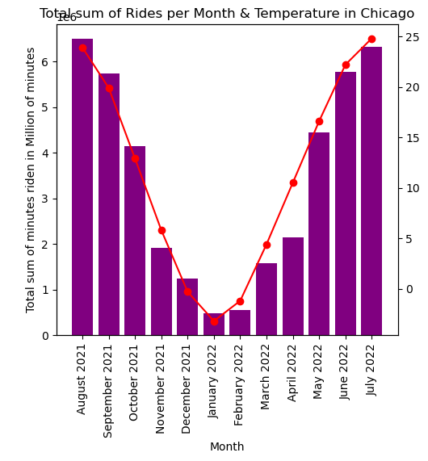
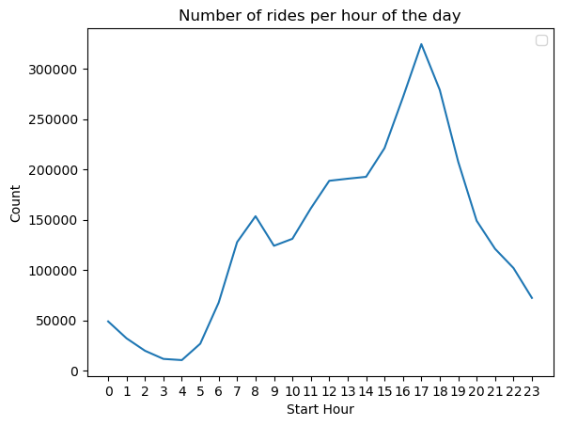
Some graphics generated
This shows total corrolation between number of rides and temperatures
This shows that people are more likely to use the bike at the end of the day (coming back home from work)
All those graphics can be used to adapt services, communications, etc.
Notes:
Bulduk

Slide 6
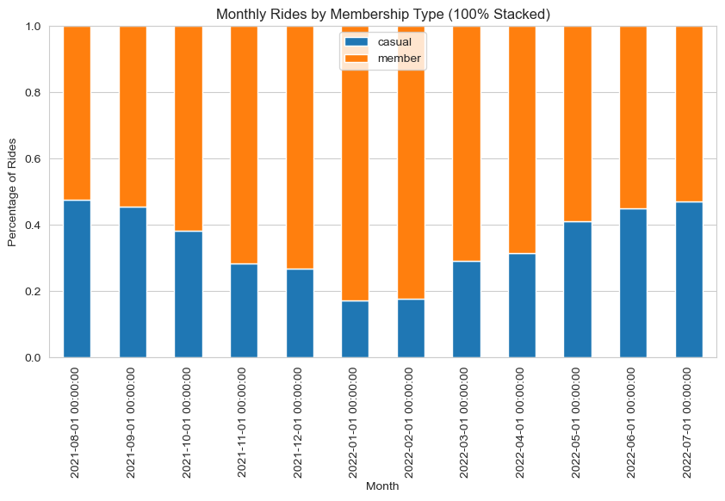
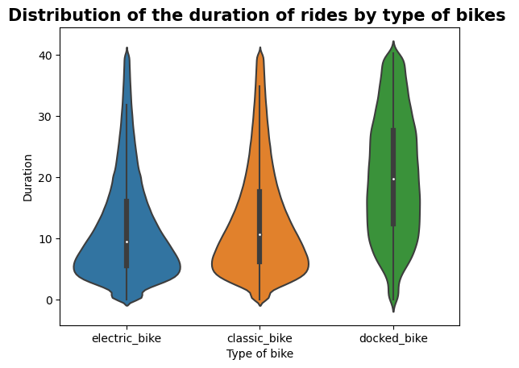
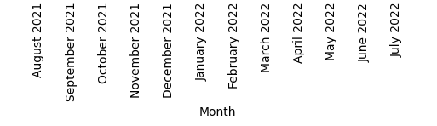
Some graphics generated
Casual members represents almost half of the users in summer (tourist?), but less than 1/3 during fall & winter
Electric and Classic tends to be used for shorter time (less than 10 minutes, mean ≈ 10)
Docked bike are used for longer time
All those graphics can be used to adapt services, communications, etc.
Notes:
Bulduk

Slide 7
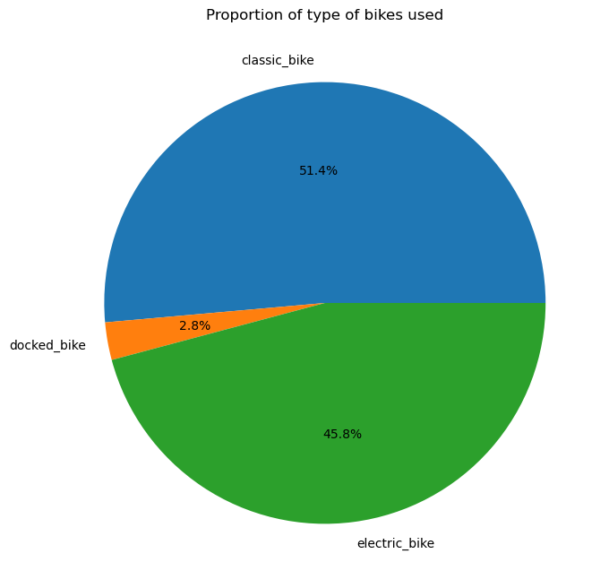
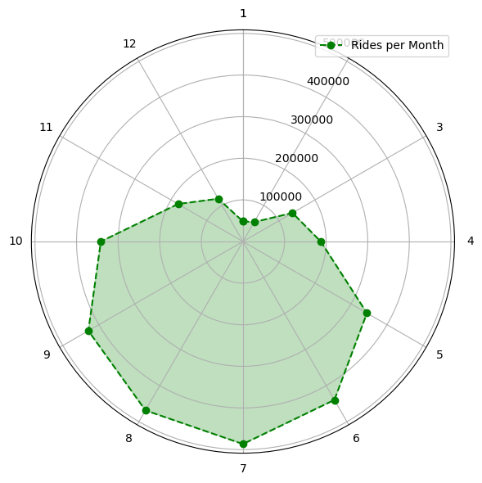
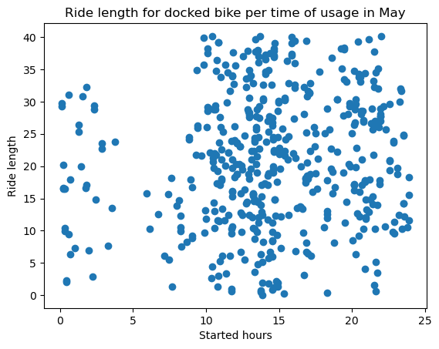
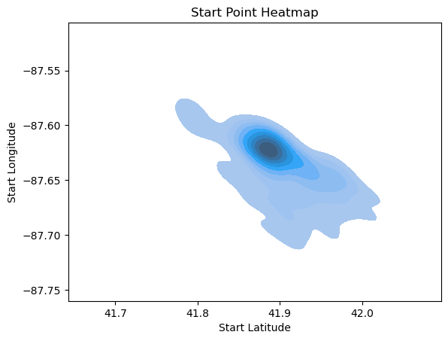
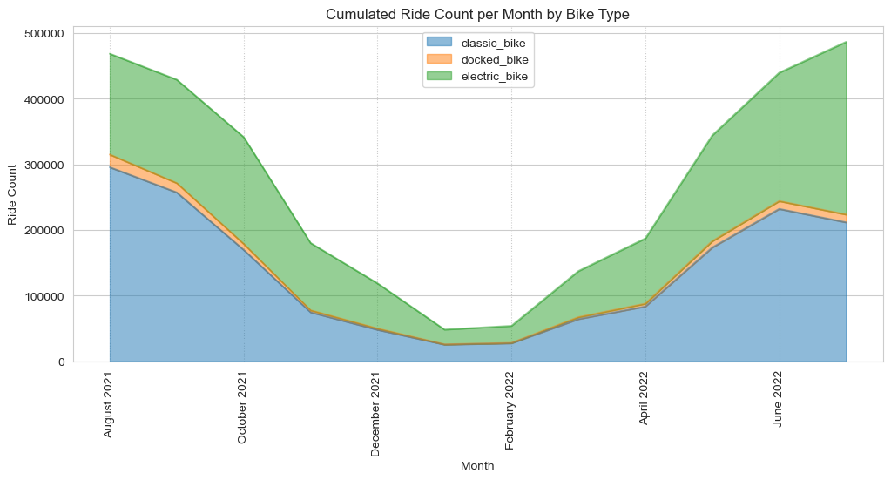
Others graphics…

Slide 8
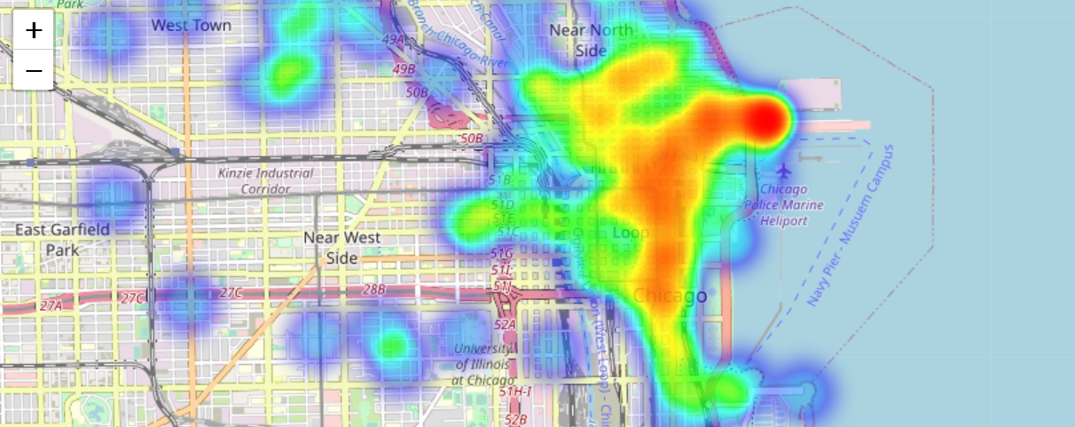
Focus on the heatmap generation
Heatmap of the starting point of docked bikes ride on the 4th of July
Notes:
Bulduk

Slide 9
Further improvements
Harmonisation of colours, labels name
Notes:
Bulduk

Slide 10
Thank you !

